Slide 1
Convolutional Neural Network
CNN Architecture and Operations
Convolutional Layers
Pooling Layers
Activation Functions in CNNs
Applications in Image Processing

Slide 2
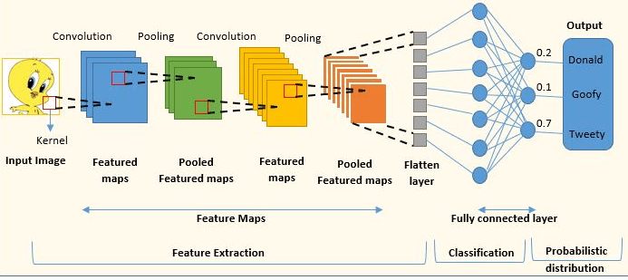
CNN Architecture and Operations

Slide 3
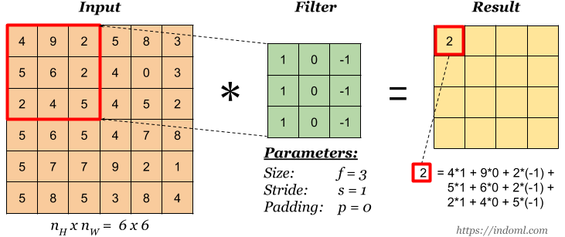
Convolutional Layer - Basic Convolution Operation

Slide 4
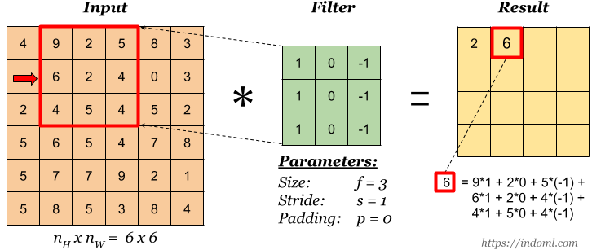
Convolutional Layer - Basic Convolution Operation

Slide 5
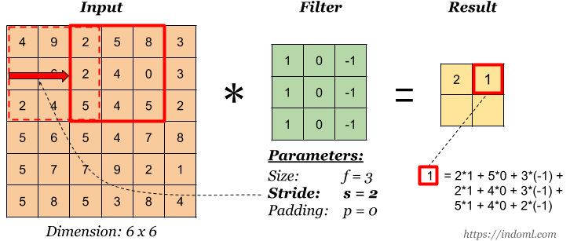
Convolutional Layer - Stride

Slide 6
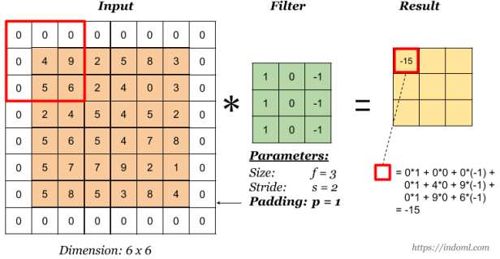
Convolutional Layer - Padding

Slide 7
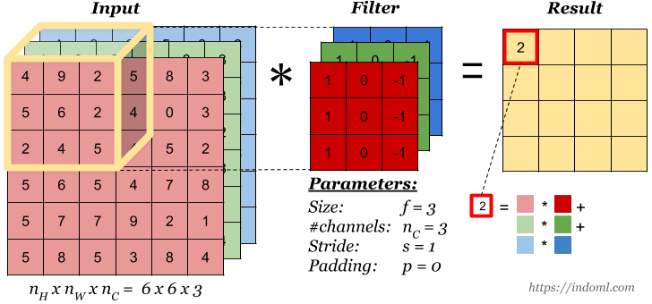
Convolution Operation on Volume

Slide 8
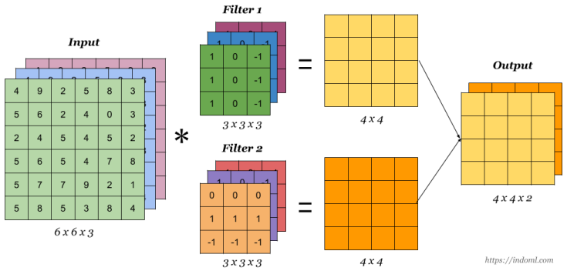
Convolution Operation with Multiple Filters

Slide 9
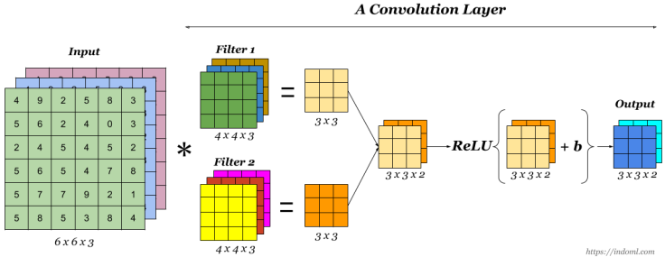
One Convolution Layer

Slide 10
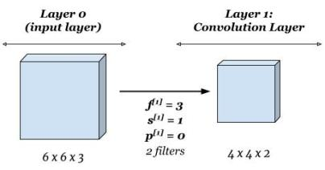
One Convolution Layer

Slide 11
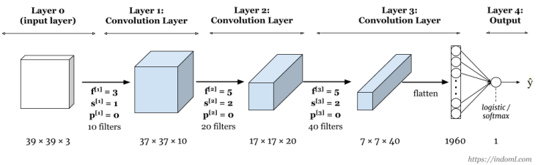
Sample Complete Network

Slide 12
Pooling Layer

Slide 13
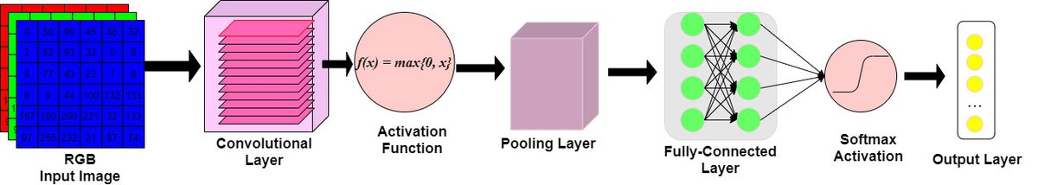
Activation Function

Slide 14
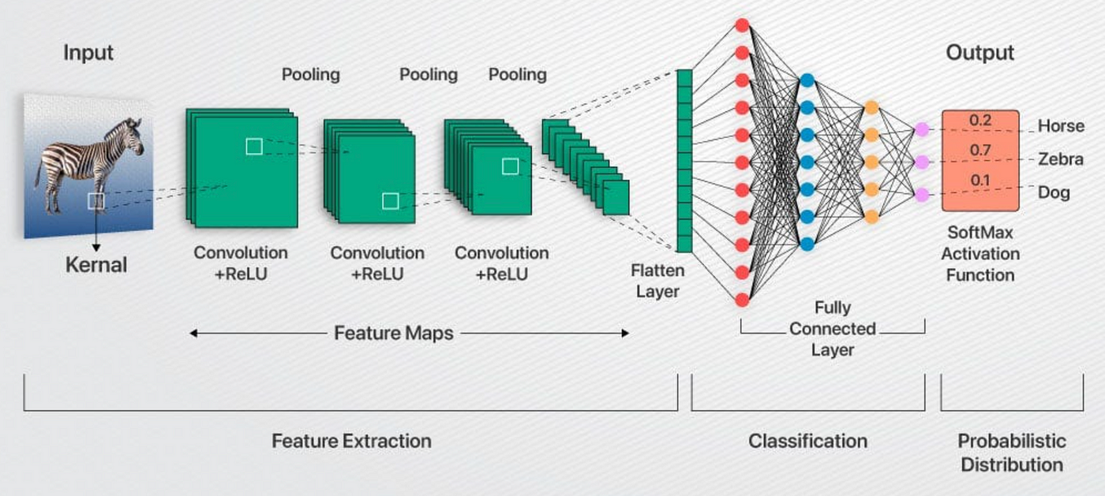
Fully Connected (FC) Layer

Slide 15
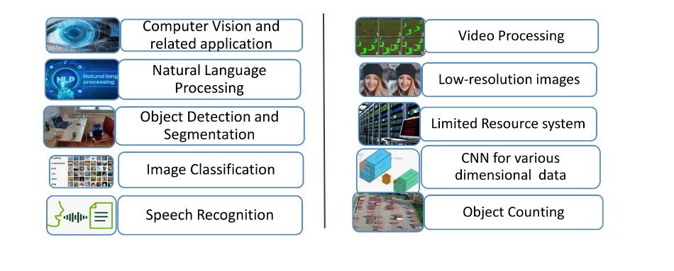
Applications in Image Processing

